Slide 1
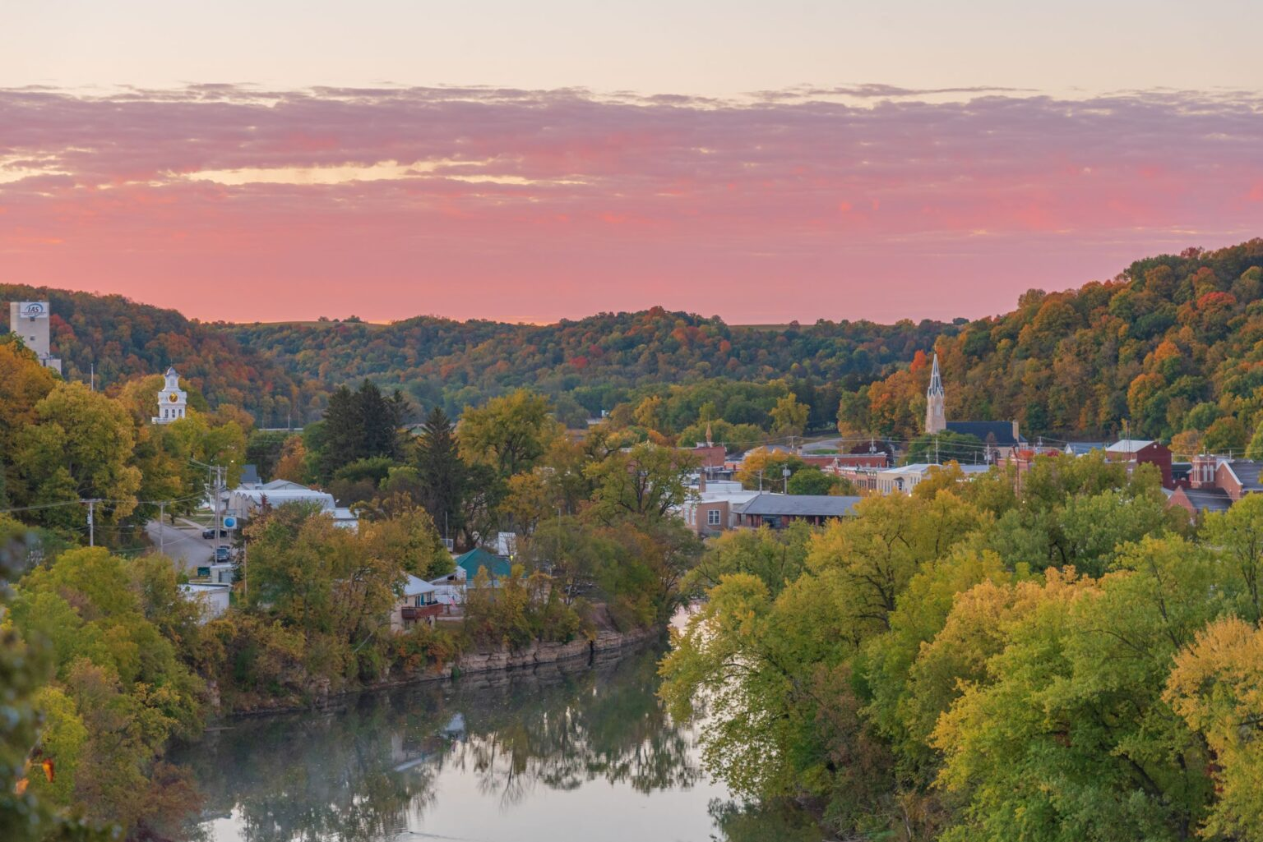


Slide 2
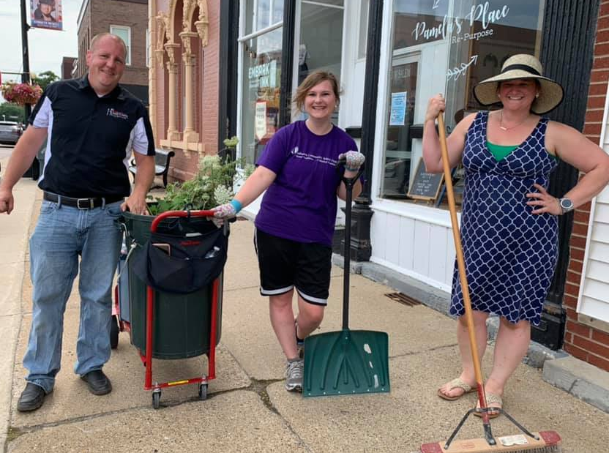
HOMETOWN PRIDE Empowering volunteers to lead community change
Hometown Pride coordinates teams of local volunteers to lead community betterment projects, with the support of a professional “community coach.” The coach and volunteers work with city leaders and existing organizations to identify unmet needs in the community and address them through volunteer-driven action. Keep Iowa Beautiful provides funding and training for the coach for 5 years (with a local funding match).
Notes:
What is Hometown Pride: Coordinate teams of local volunteers to lead community betterment projects, with the support of a professional “community coach.” The Hometown Pride coach and volunteers work with city leaders and existing organizations to identify unmet needs in the community and address them through volunteer-driven action. Keep Iowa Beautiful provides funding and training for the coach for 5 years (with a local funding match).

Slide 3
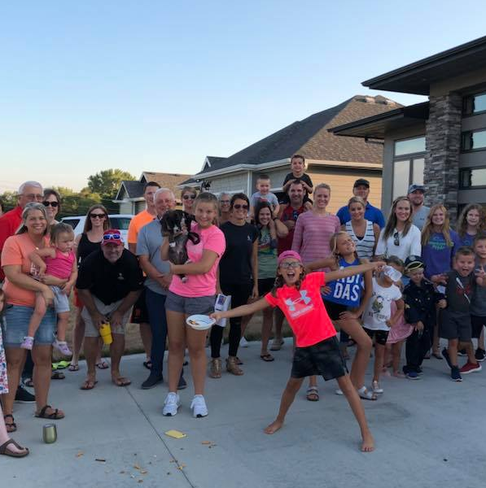
Why we do Hometown Pride
Research shows, the most successful towns have…
High civic engagement: residents are “involved in community improvement projects”
Shared leadership: “people in the community achieve shared goals together”
Sources: “What Drives Quality of Life in Iowa Small Towns?” – D. Peters, ISU, 2017; Source: “Why Leadership Matters for Rural Community Vitality in Iowa” – ISU, 2020
Notes:
What Drives Quality of Life in Iowa Small Towns?
https://shop.iastate.edu/extension/community-development/community-and-leadership/economic-development/soc3082.html
Data: Study of 99 small towns over more than 20 years
Why Leadership Matters for Rural Community Vitality in Iowa:
https://shop.iastate.edu/extension/community-development/community-and-leadership/soc3093.html

Slide 4
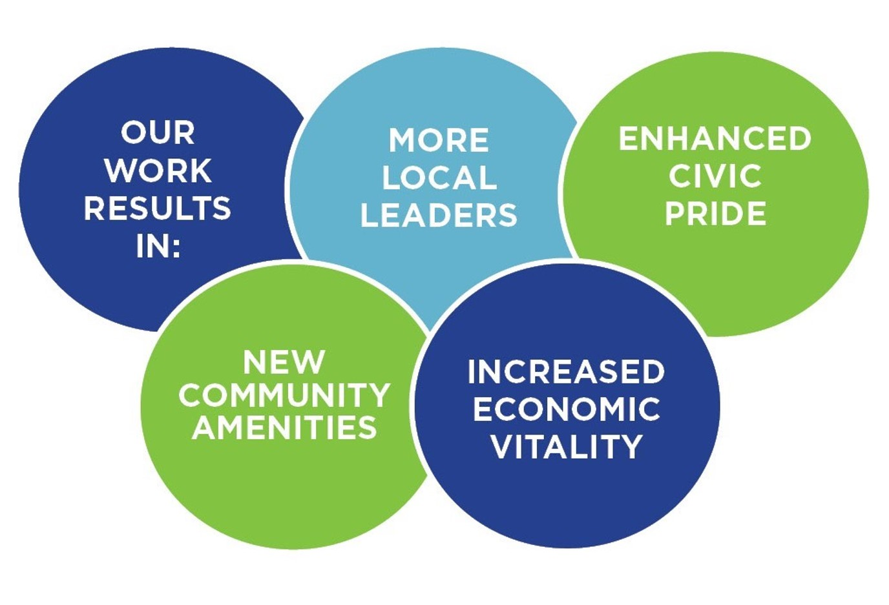
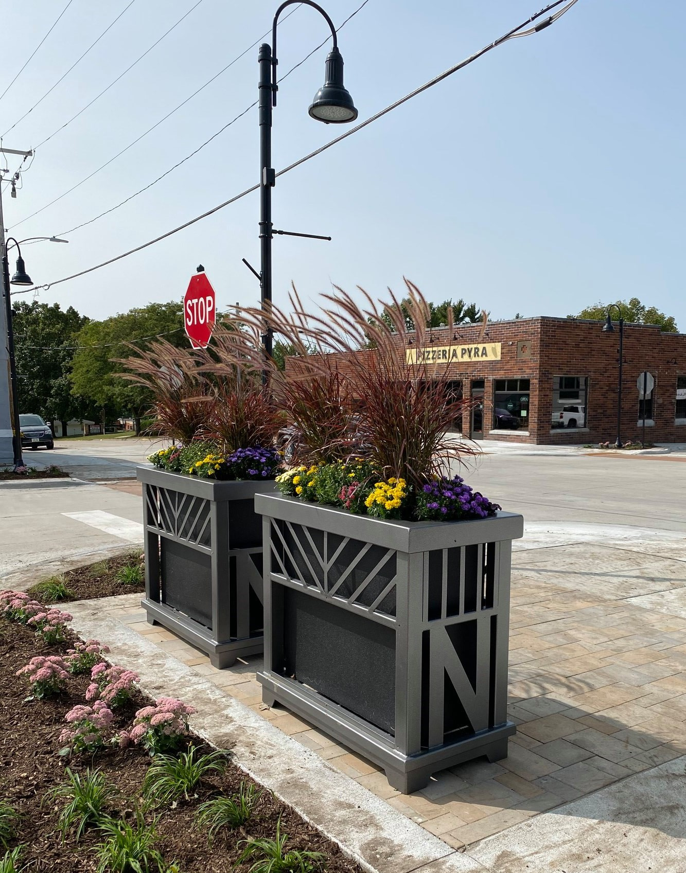
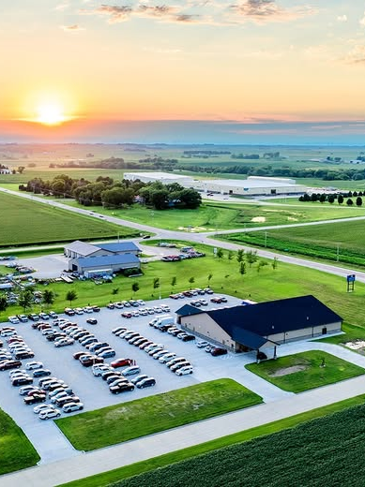
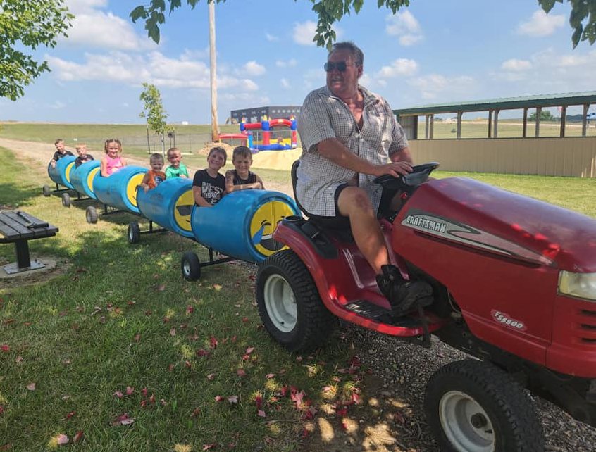
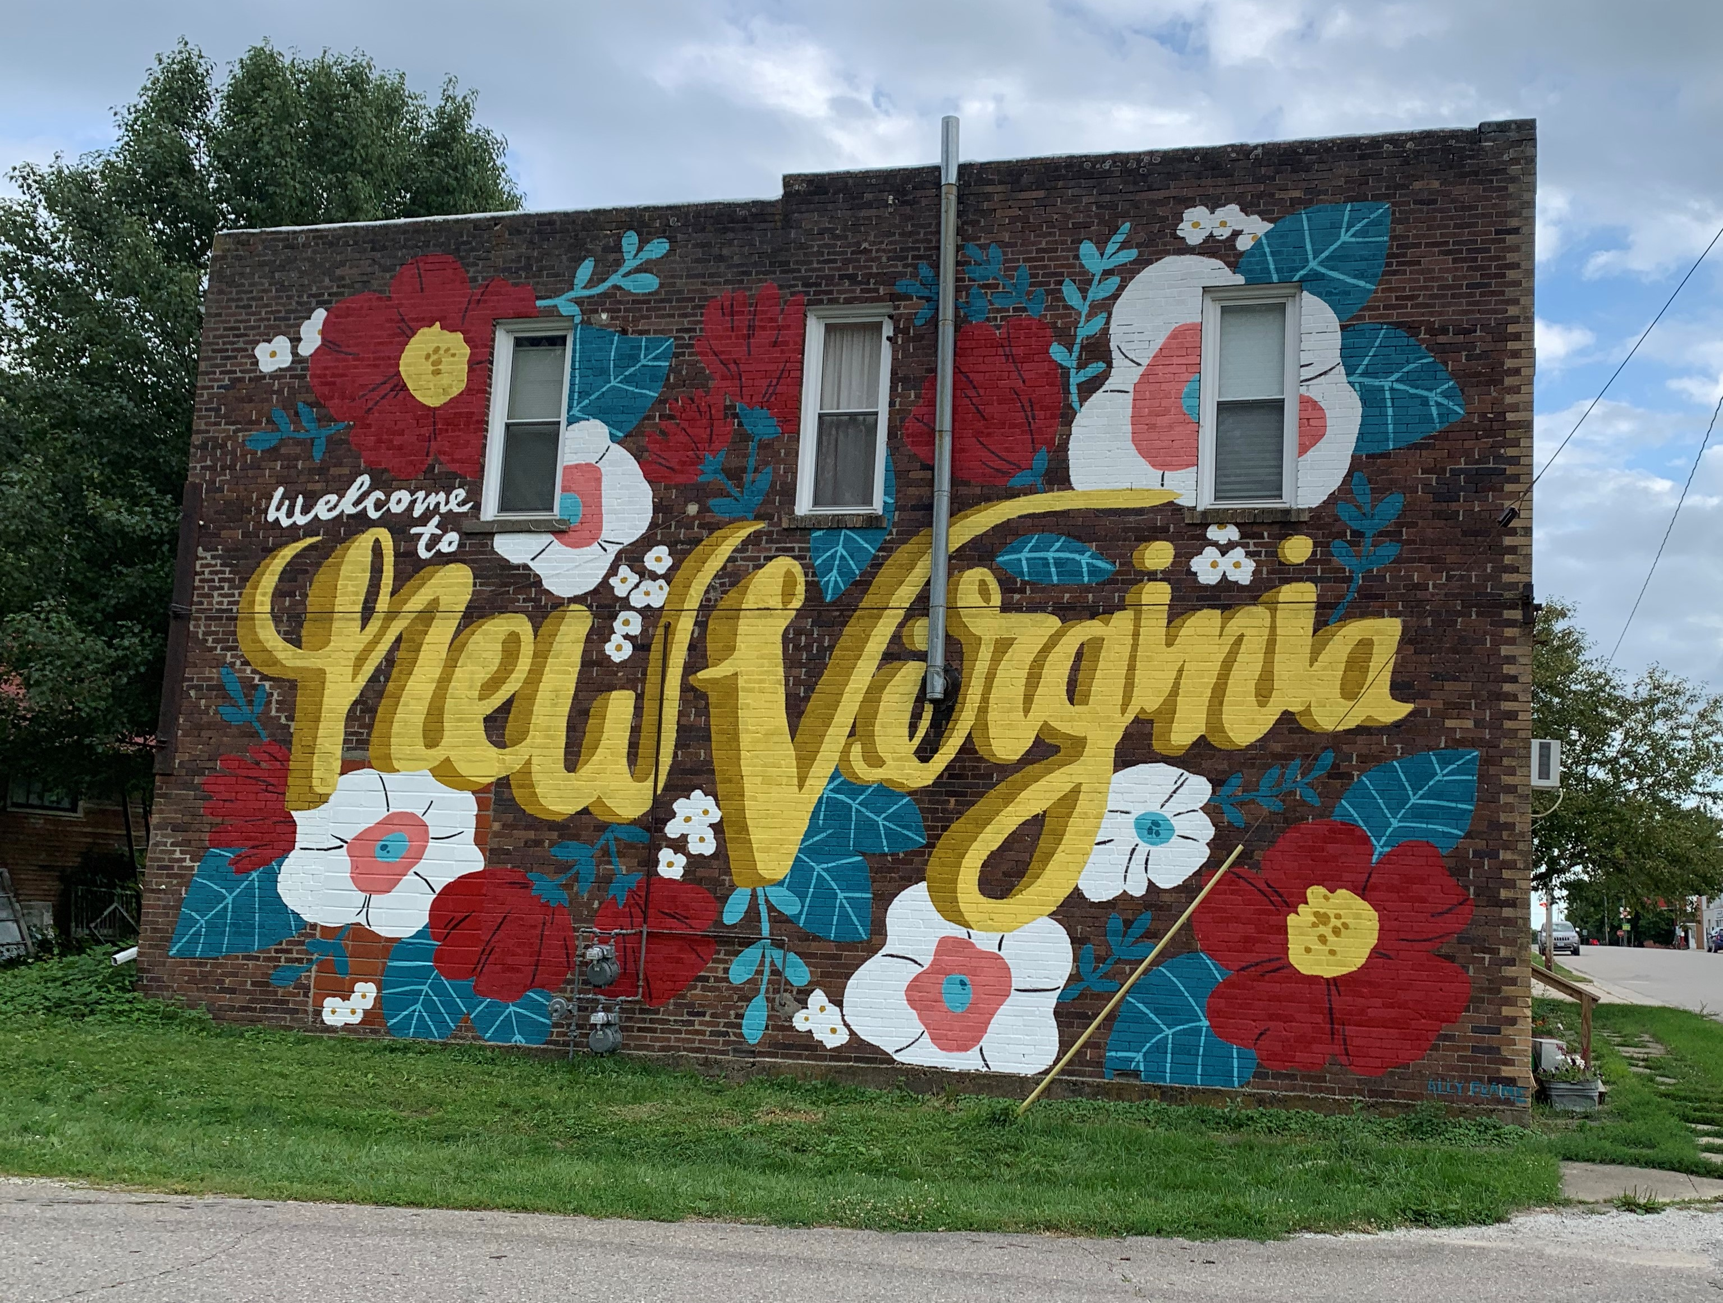
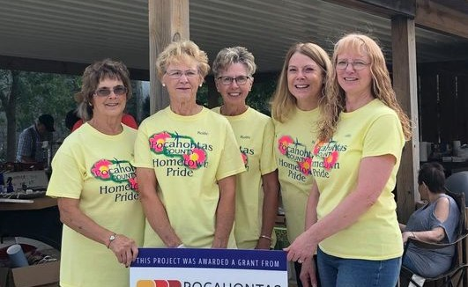
Notes:
4 primary outcomes: Foster more local leaders, enhance civic pride, add new community amenities, increase economic vitality
Notes on program outcomes:
More Local Leaders: Each region engages 150-200 local residents as volunteers, helping build leadership skills and deepen the bench of community leaders. Incredibly valuable for the long-term vitality of the town.
As a result of successful improvement projects and enhanced leadership, towns see more civic pride and a boost in economic vitality
Pictures of Hometown Pride projects/volunteers: Flower planters in Norwalk downtown, Lake view community center, Luxemburg festival, New Virginia mural, Pocahontas volunteers celebrating completion of project with local grant

Slide 5
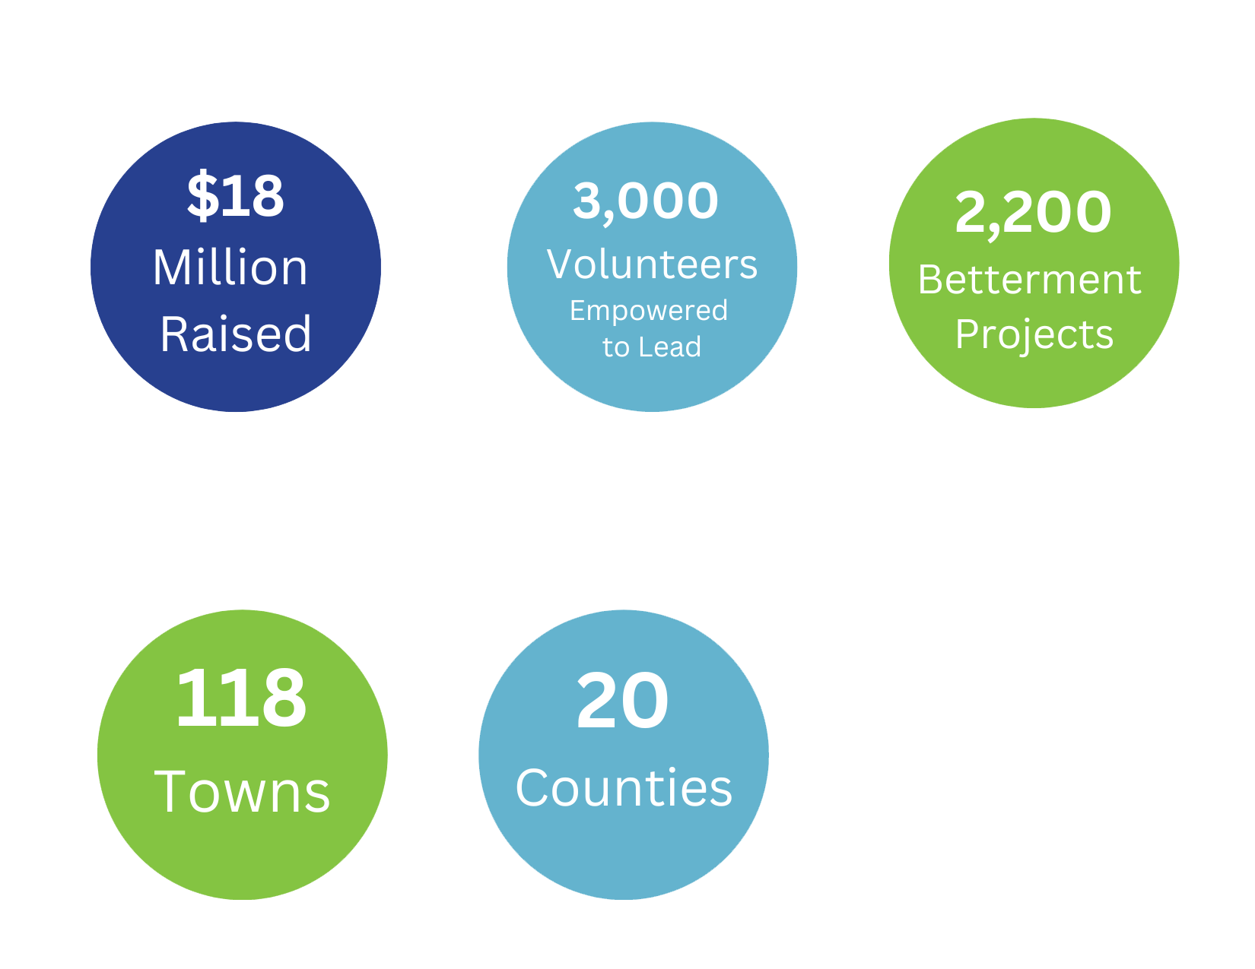
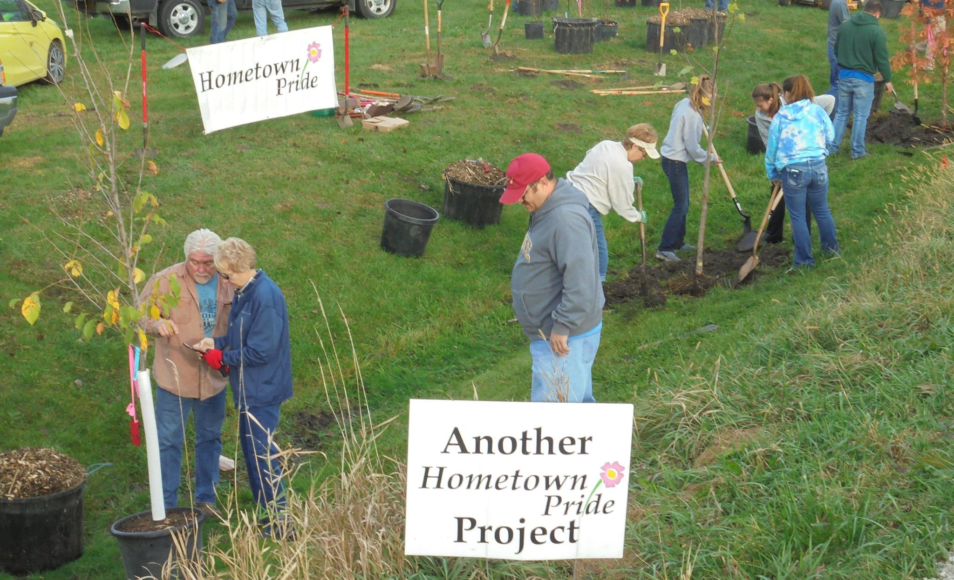
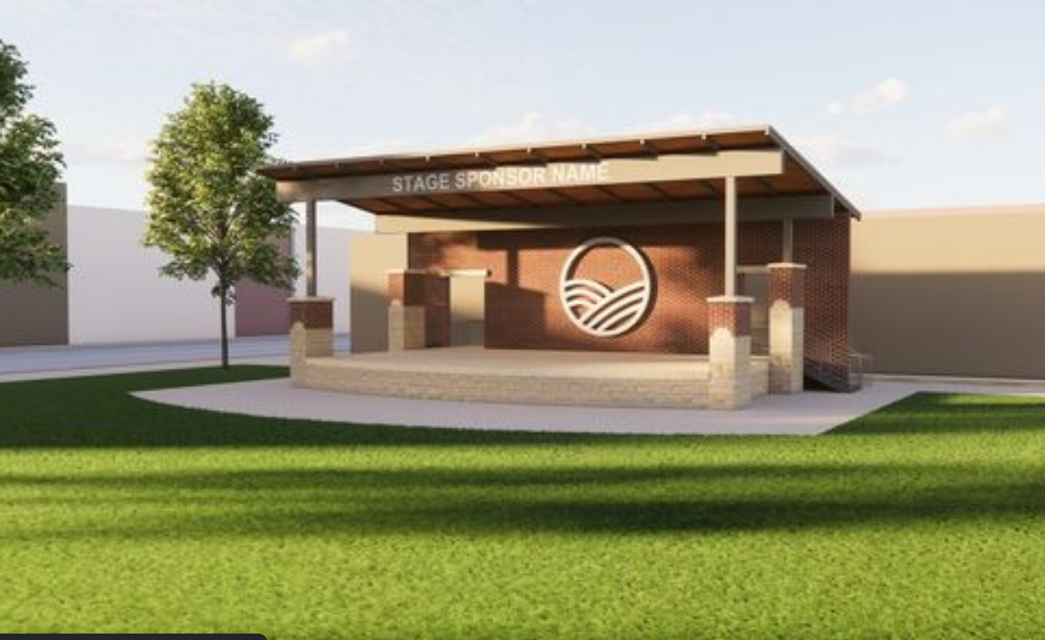
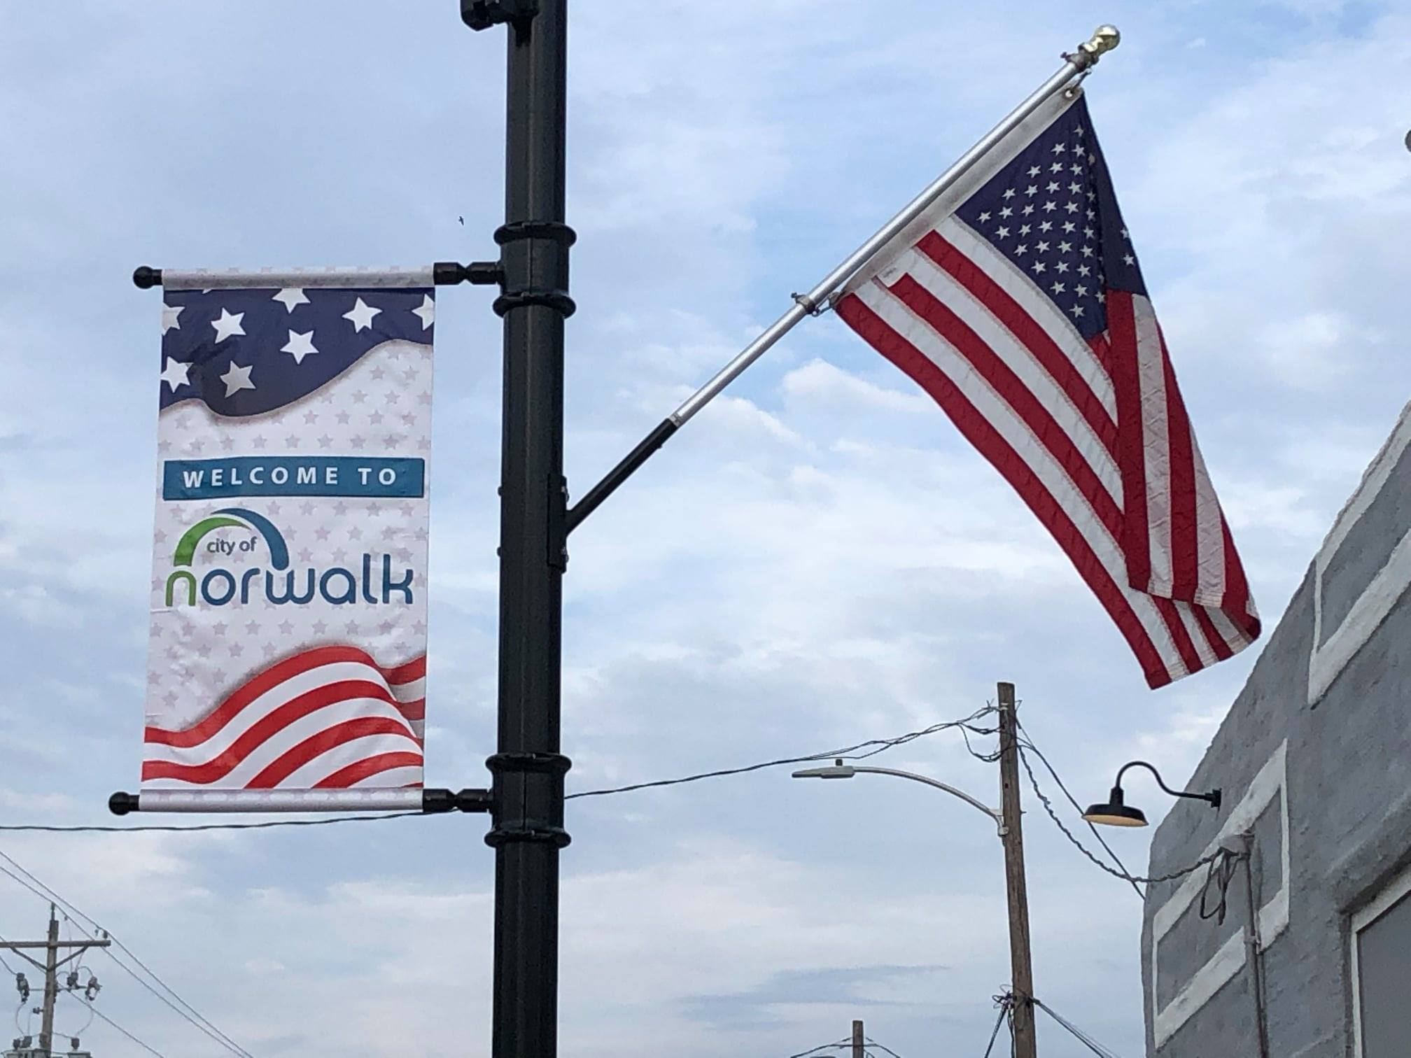
Notes:
Pictures of HTP projects: Rendering of $1M+ Maquoketa downtown park; Louisa County tree planting; Norwalk light pole banners

Slide 6
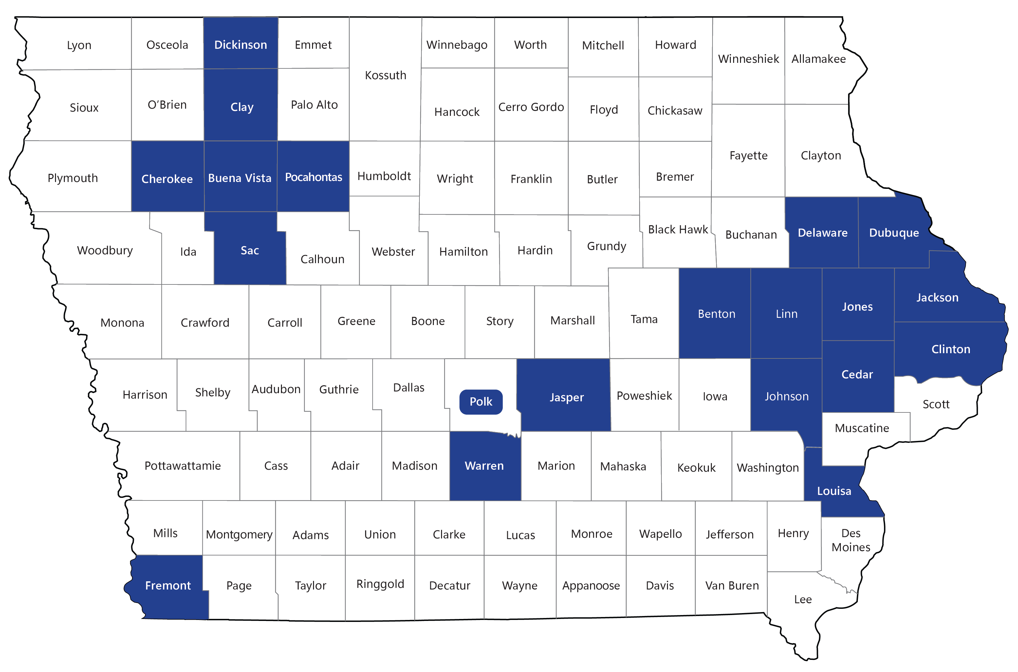
Hometown Pride Participants 100+ towns in 20 counties over 13 years (est. 2012) Applications open for new communities in 2026!

Slide 7
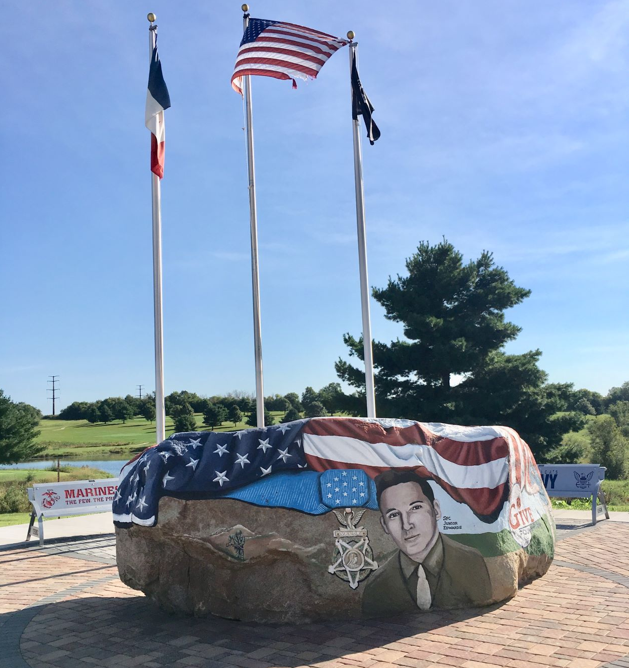
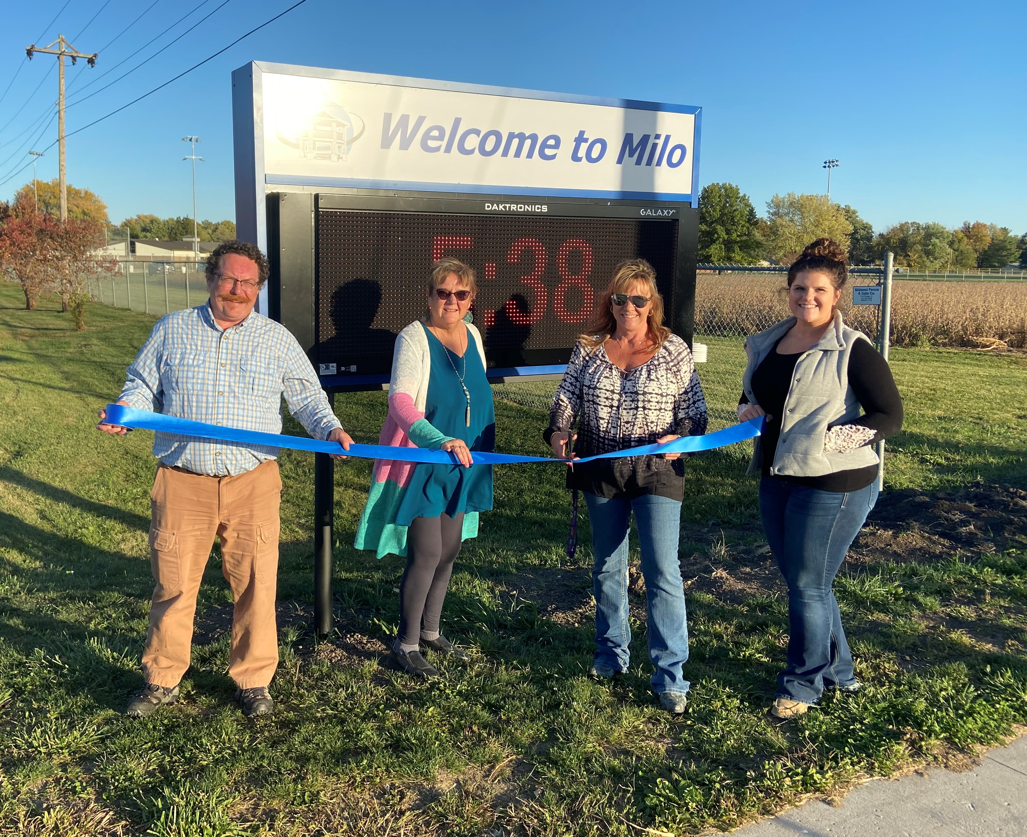
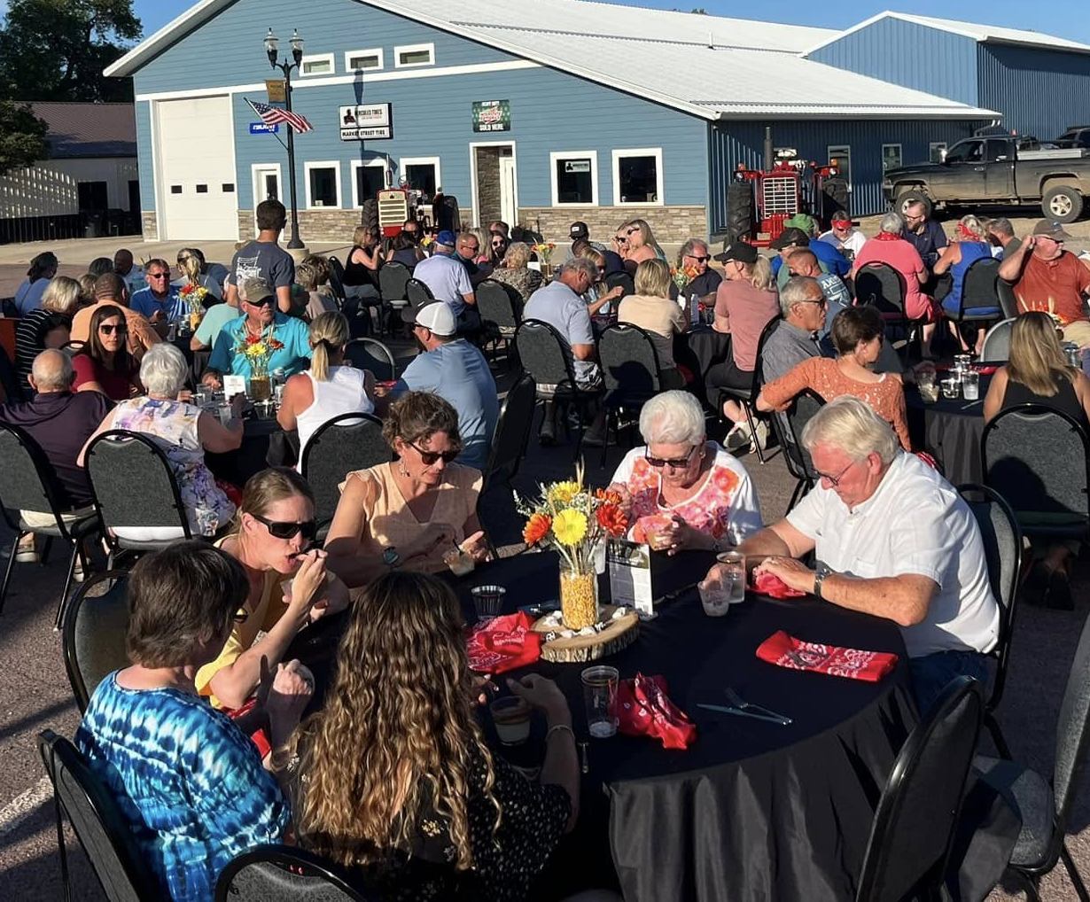
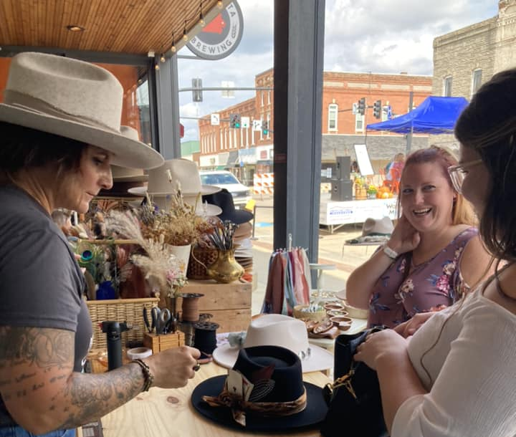
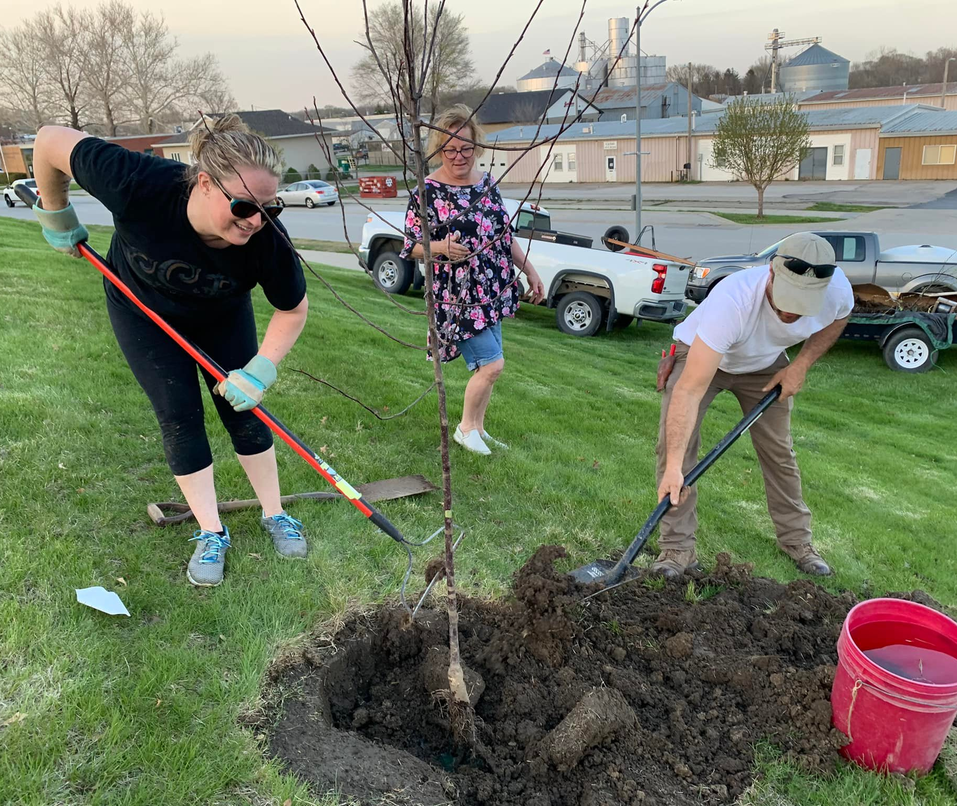
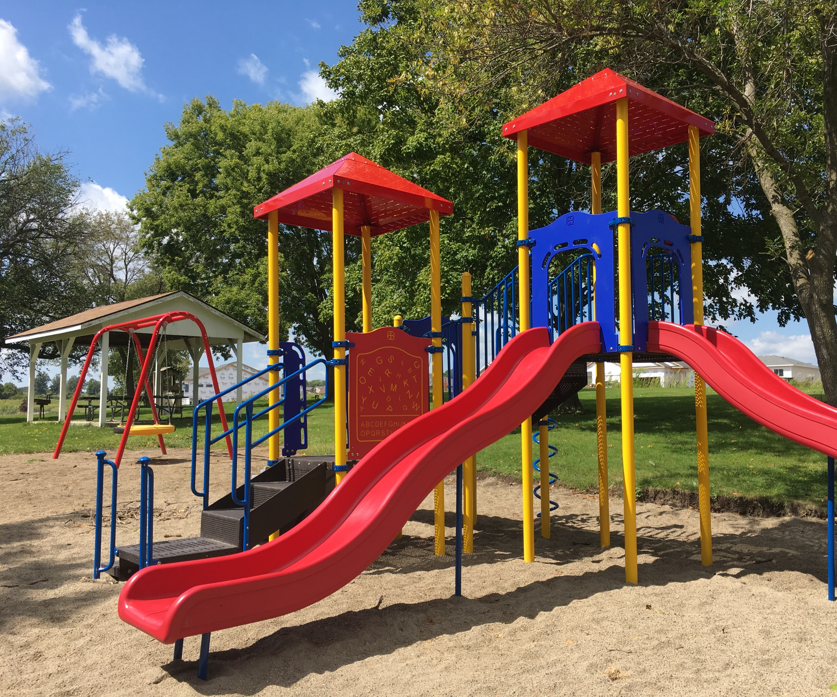
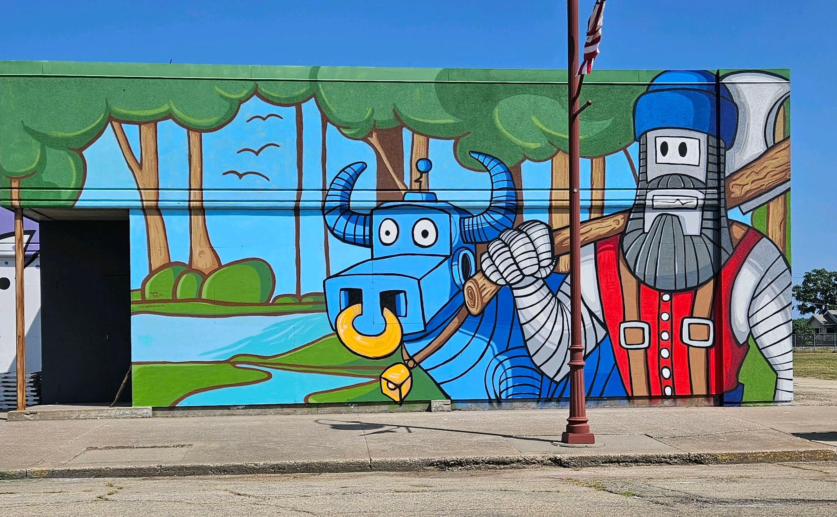
Notes:
Types of projects - public art, festivals, clean-ups, welcome signs, park improvements, trails, volunteer skill-building/leadership training
Impact of these projects: provide new amenities, enhance civic pride, encourage economic activity, leadership skill-building among our volunteers – the coach supports volunteers in learning new leadership skills “on the job” (e.g. grant writing, leading meetings, etc)
Pictures of Hometown Pride projects: Warren County veteran’s memorial, Milo welcome sign, Lake Park “farm to fork” dinner, Clinton mural, tree planting day, Carlisle playground

Slide 8
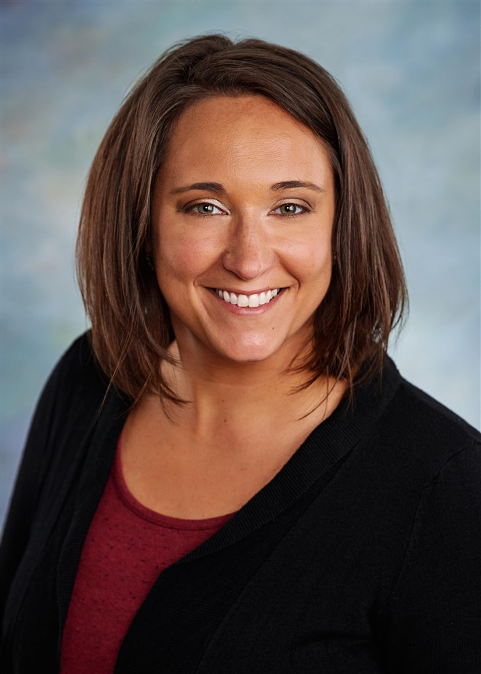
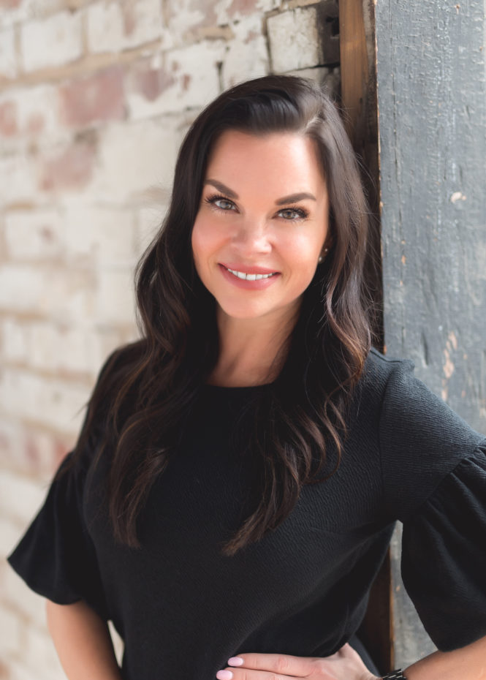
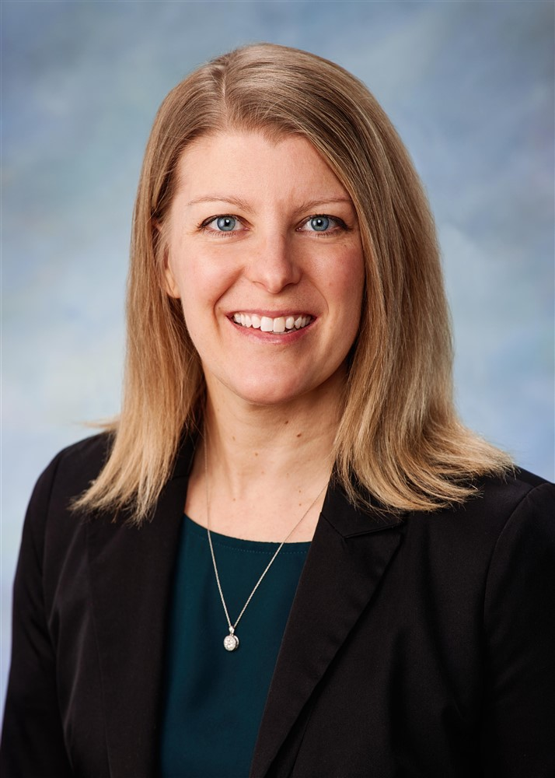
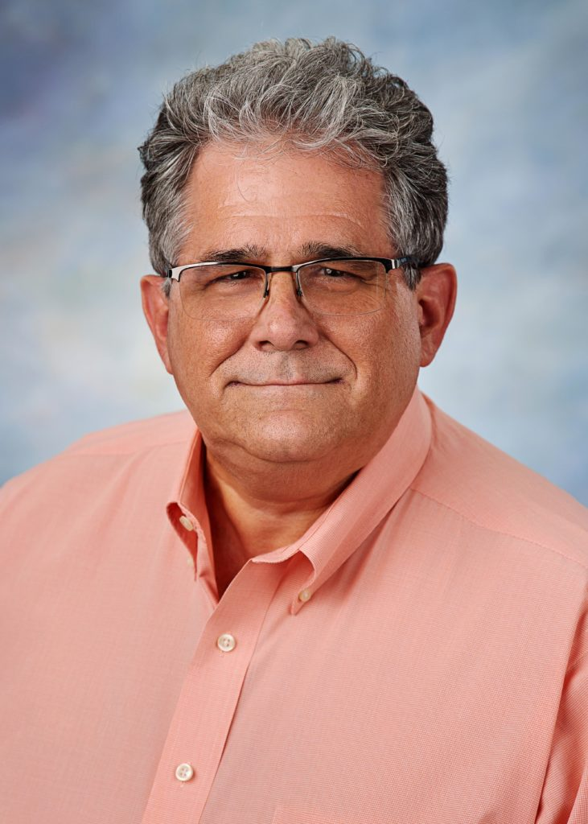
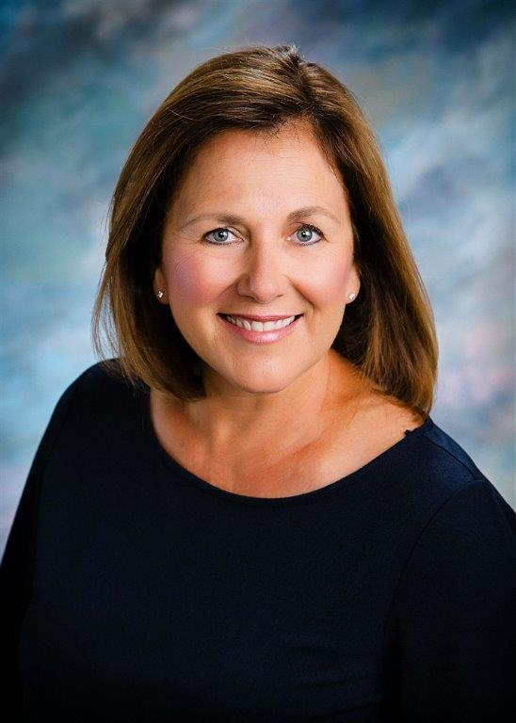
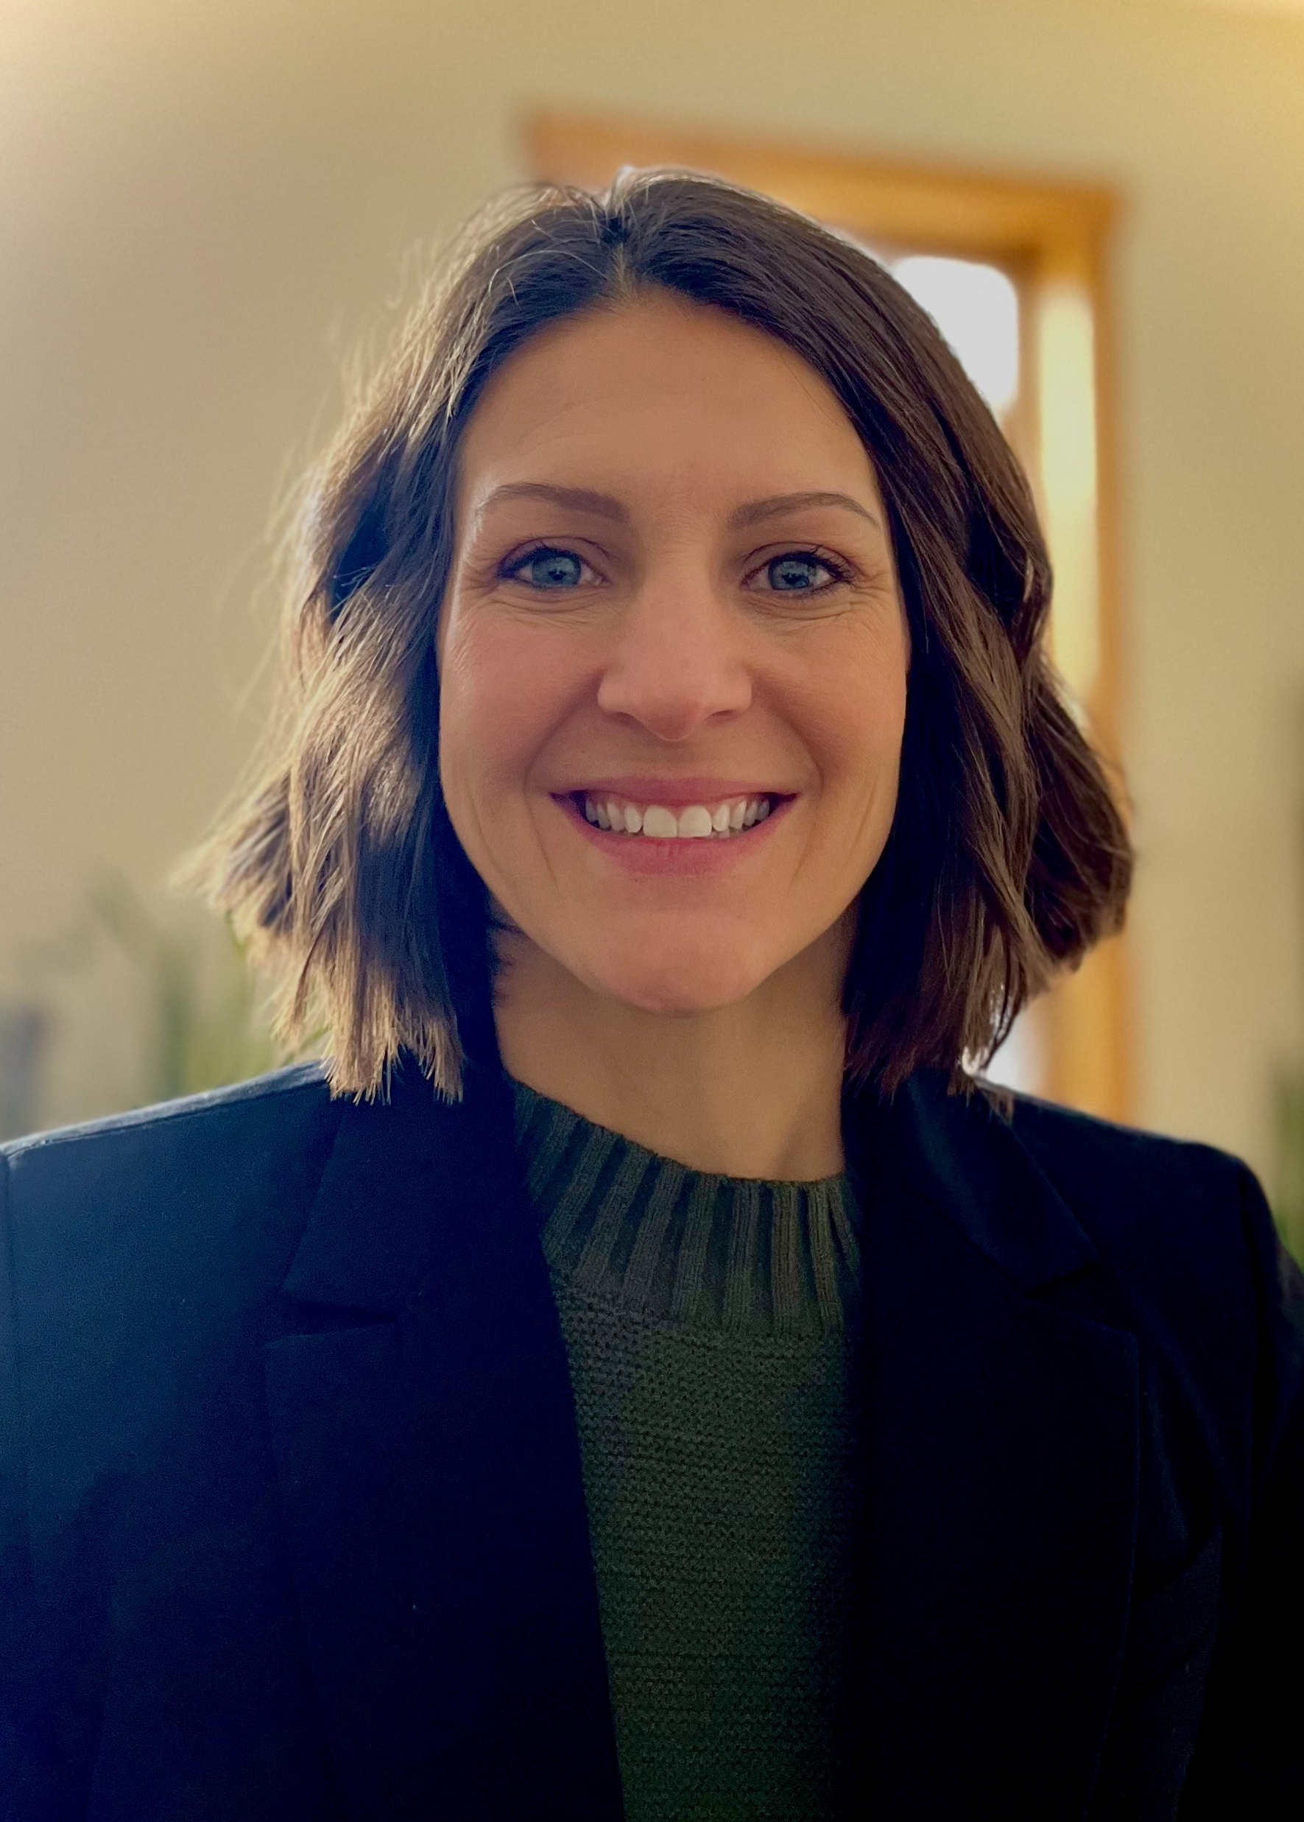
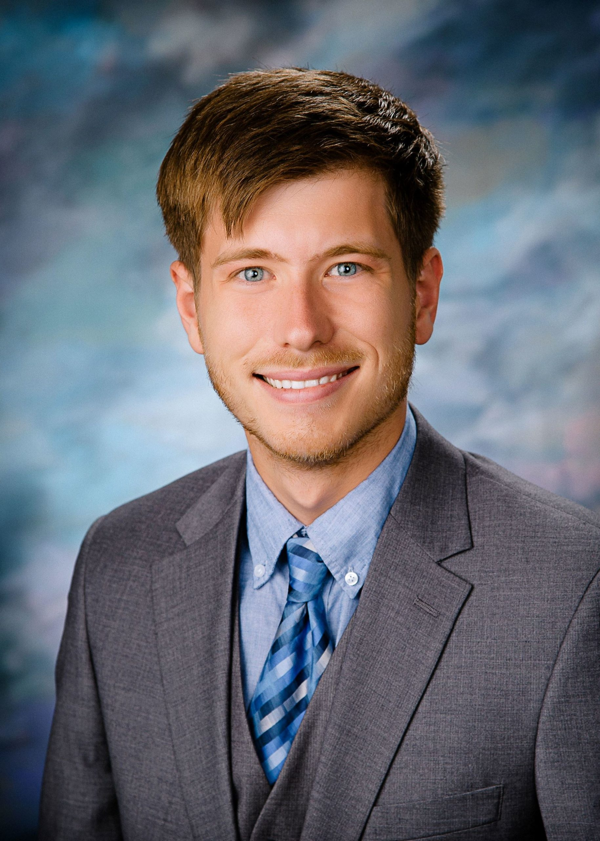
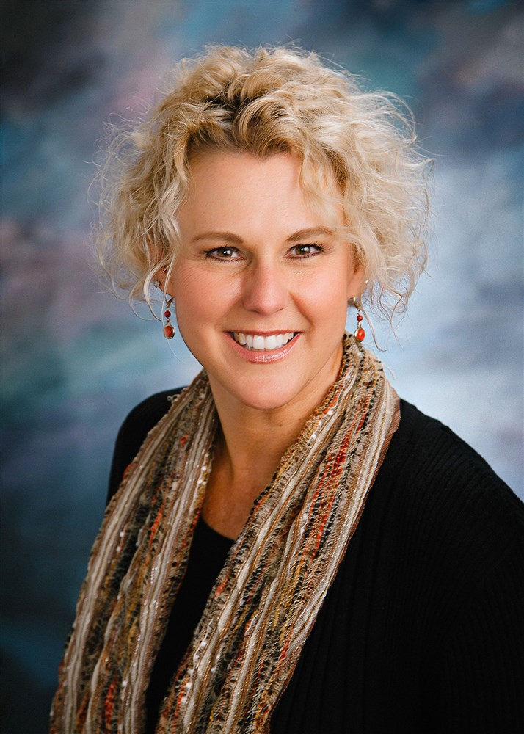
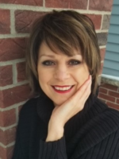
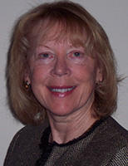
HOMETOWN PRIDE COACHes
Coaches advise and assist on:
recruiting and empowering volunteers
fundraising and grant-writing
creating action plans
identifying project opportunities
completing projects
collaborating with community groups
Notes:
Coach works with Hometown Pride volunteers and local leaders to identify what needs the community has. We look at existing plans and organizations to see what is already being done and what gaps exist so we can take on community betterment projects that advance your town’s goals.
Each coach serves a group of 6-8 communities in one geographic area (1 county or 2 adjacent counties).
Coaches advise and assist on: recruiting and empowering volunteers, creating action plans, identifying opportunities for community betterment, completing projects, fundraising and grant-writing, collaborating with other community groups
Communities participate in hiring their coach

Slide 9
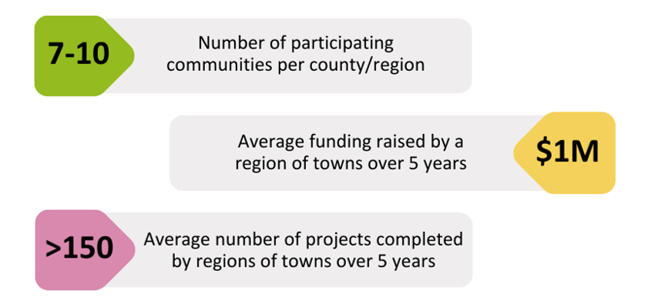
Regional Impact
6-8
Resident volunteers leading community change
200+
Notes:
Program Outcomes:
Betterment Projects/$$: Typical town will accomplish 15-20 projects, and raise $150,000-$200,000 over 5 years
Multiply by 6-8 participating communities. On average our groups of towns raise over $1M and complete more than 150 projects for their region and have 150-200 volunteer participate in HTP projects
Excellent return on investment – compare $1M+ raised to the $20k/yr regional investment over 5 years. And the return is actually much higher, when considering non-monetary benefits of the program and the value of volunteer time.

Slide 10
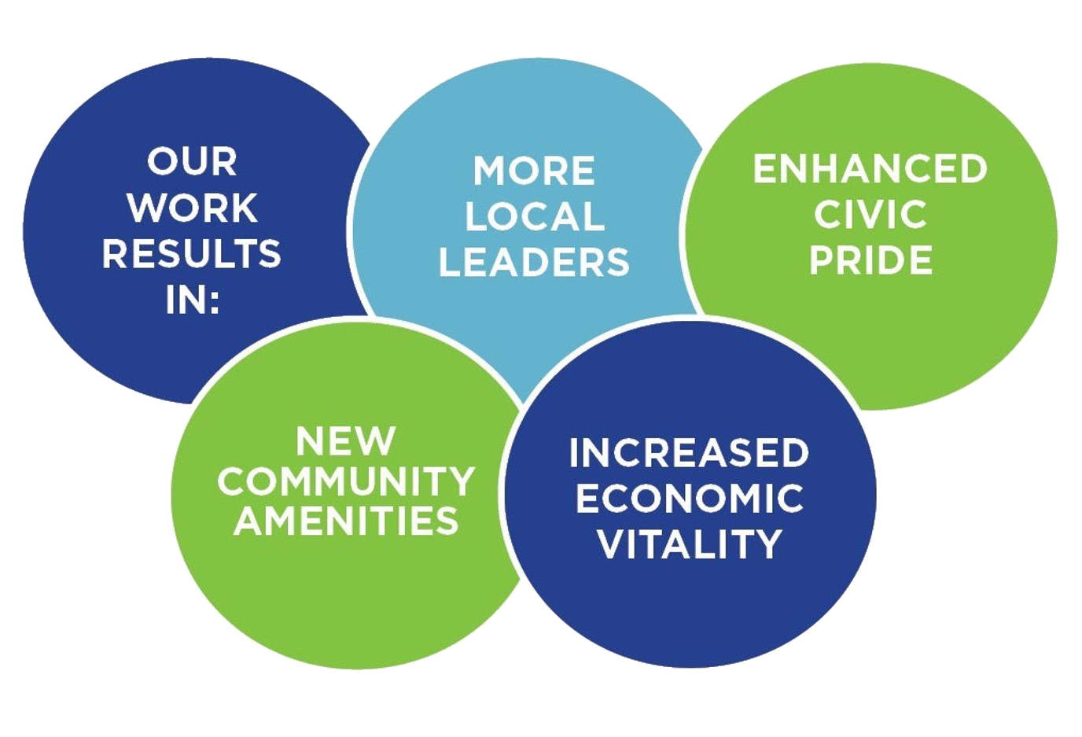
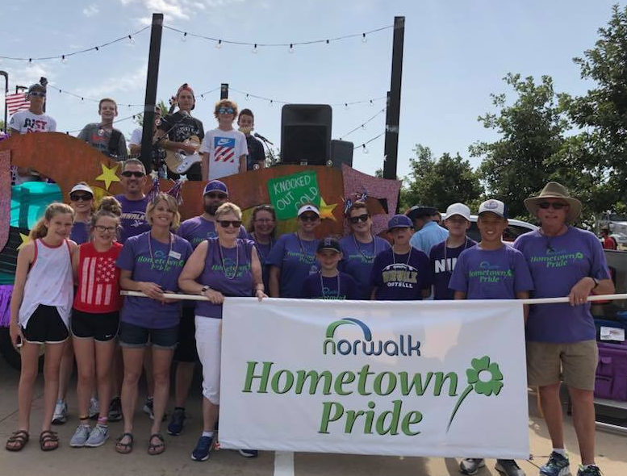
IMPACT
Notes:
Notes on program outcomes:
More Local Leaders: Each region engages 150-200 local residents as volunteers, helping build leadership skills and deepen the bench of community leaders. Incredibly valuable for the long-term vitality of the town.
As a result of successful improvement projects and enhanced leadership, towns see more civic pride and a boost in economic vitality
Funding for coach provided for 5 years, but towns continue beyond 5 years – either by finding local funding to continue the coach position, or by continuing as a volunteer-led program.

Slide 11
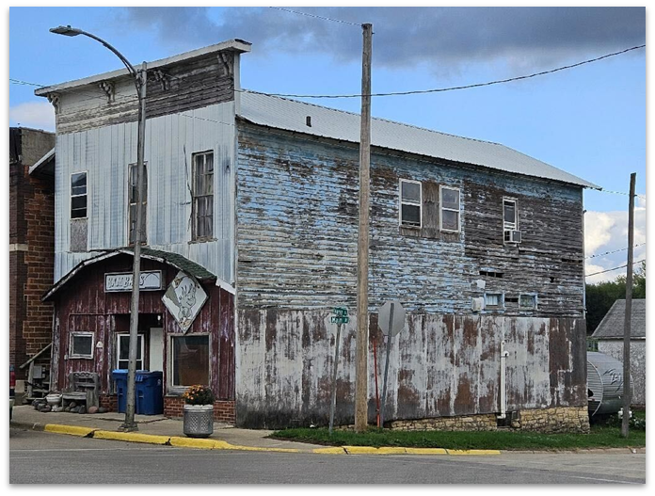
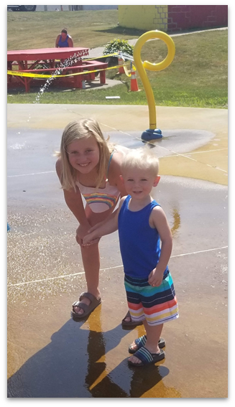
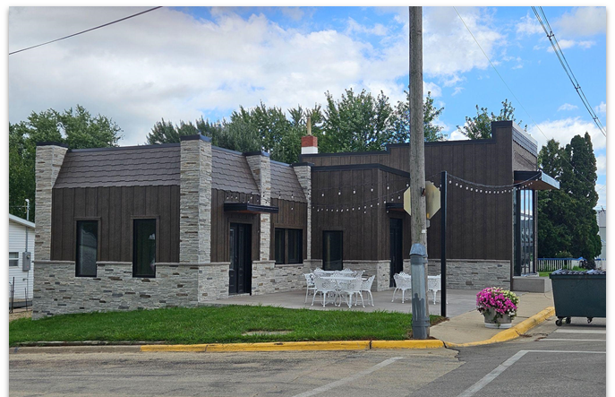
Success story delmar
Notes:
Success story:
Delmar. Eastern IA. Population 500.
After 20 years of no construction and no new amenities in town:
Hometown Pride committee started and successfully brought a Splash pad to town.
Big success of the splash pad was the catalyst for building renovations and new businesses.
In years that followed, Delmar added 5 new businesses and 7 new homes ($2M of investment) in 6 years – business owners credited the success of Hometown Pride, seeing people come together, with giving them confidence to invest
The Hometown Pride committee continued with more successful projects: mural, depot renovation, etc.
Hometown Pride also cultivated new leadership – volunteers with the committee have gone on to serve on city council and other leadership roles

Slide 12
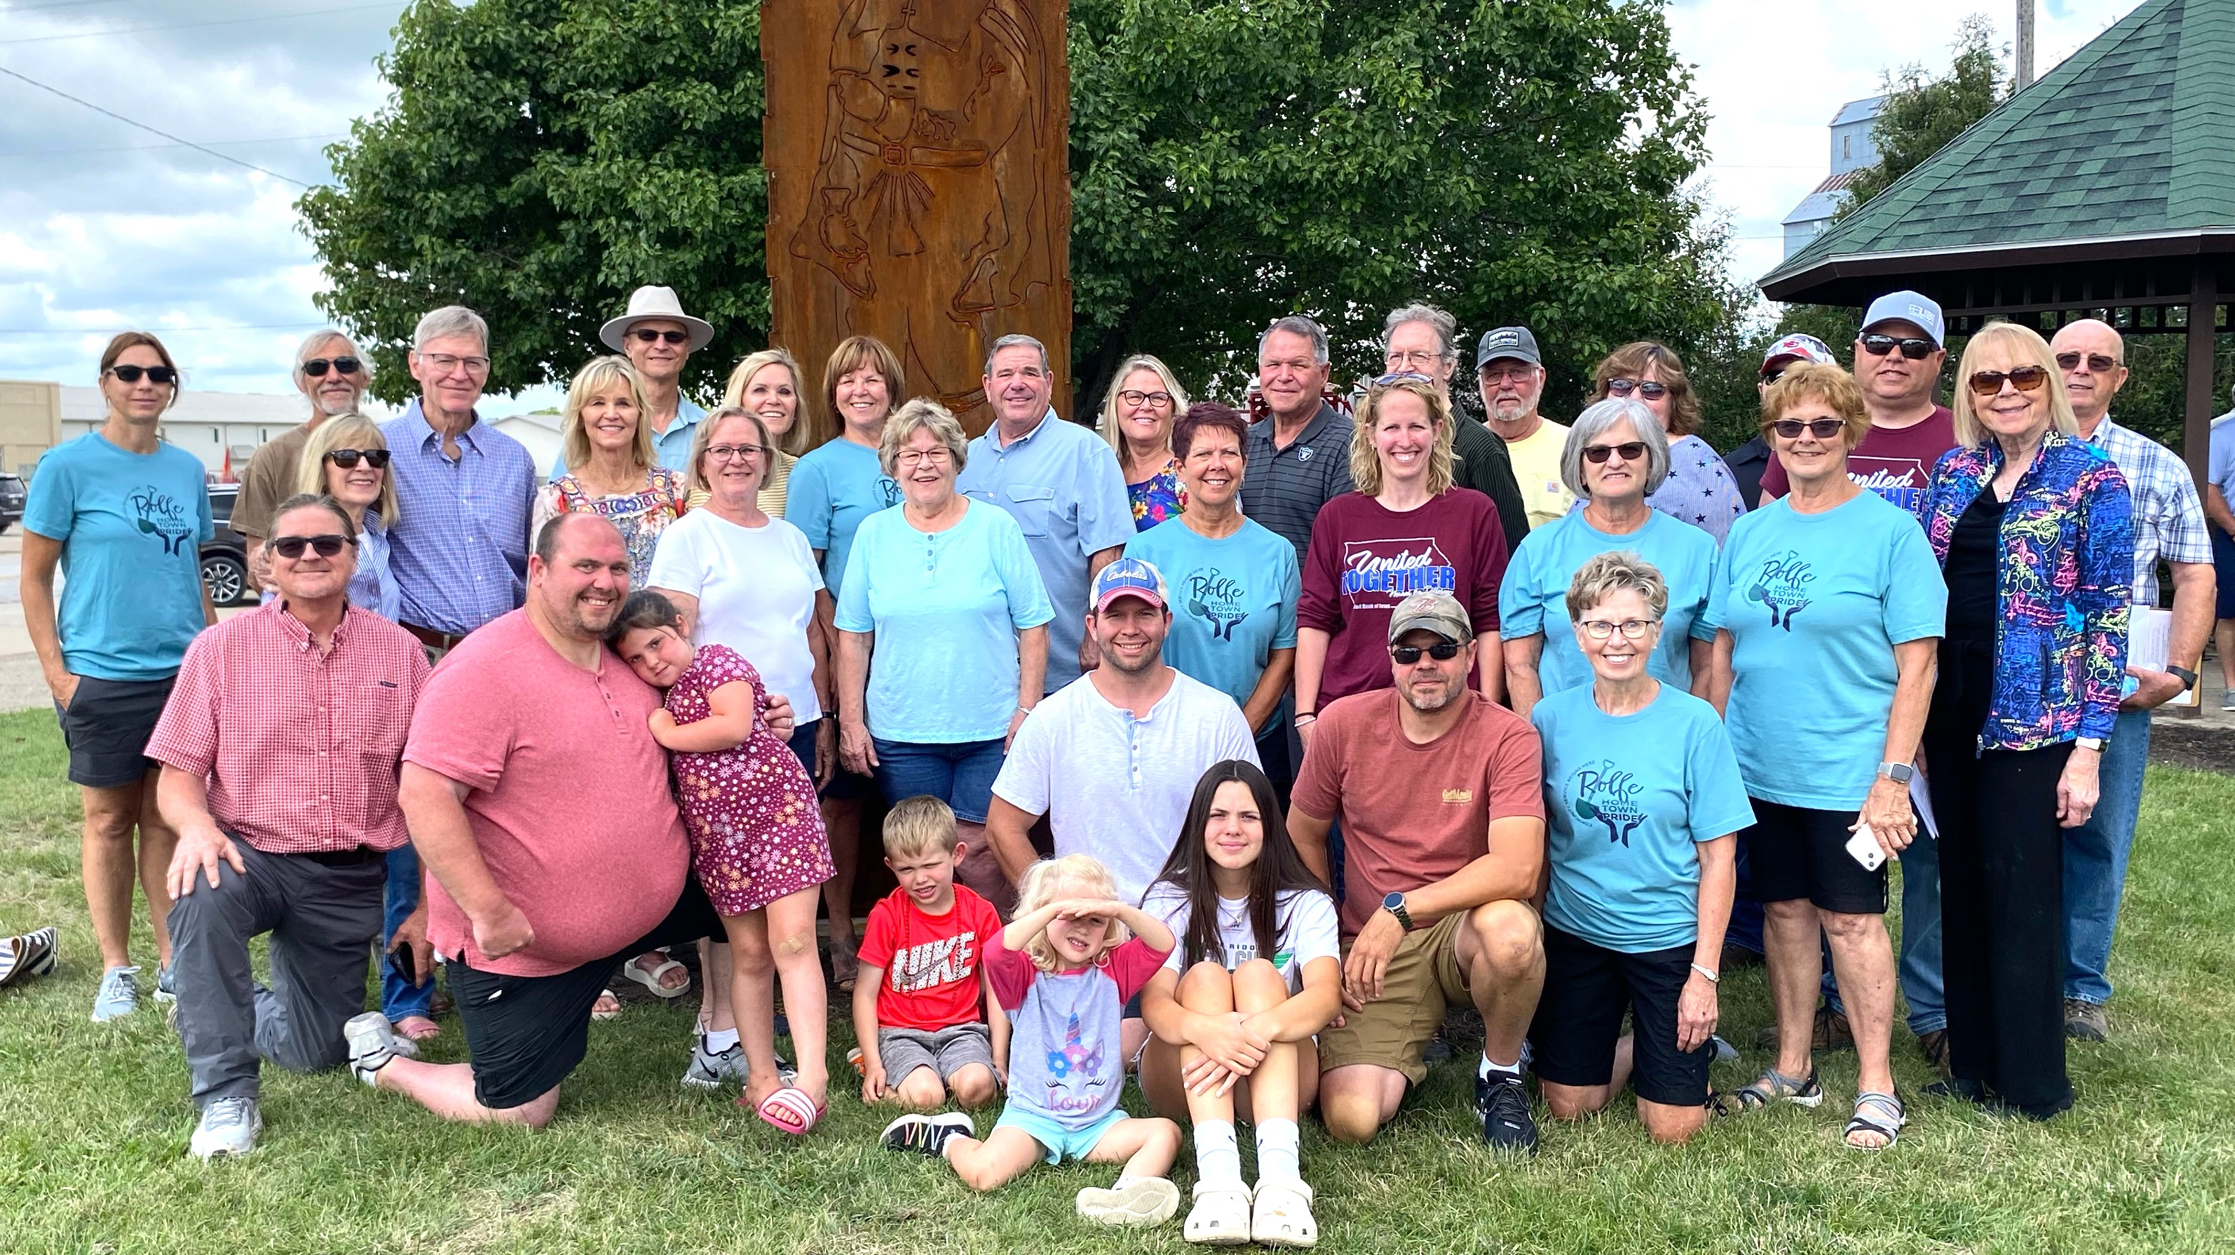
Success story Pocahontas county
Notes:
Success story:
Pocahontas County. In 13th year of the program. 7,000 people in county
Have completed 300 projects and raised $2 M for 9 communities.
After the 5 years were over, they created a permanent coach position that is locally funded
Established permanent funding sources for their Hometown Pride committees with their community foundation.
Have seen great developments in local leadership – a leadership program emerged out of HTP

Slide 13
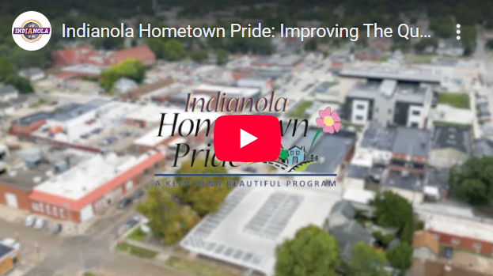
Indianola video
https://www.youtube.com/watch?v=ex_kpsheB8A

Slide 14

HOW TO JOIN
Talk to KIB staff first.
Identify 6-8 prospective communities in one county or a 2-county region, and reach out to local leaders
Recruit community “champion” for each town
Secure 5-year pledges for local funding match
Get resolution of support from local governments
Submit “statement of interest” by February 6
Notes:
Reach out to leaders in each community such as elected officials, chamber of commerce, economic development agency, community betterment organizations. KIB staff can participate in conversations with local leaders virtually or in person
Local funding match
KIB is paying 75% of the total cost to run the program. Participating communities contribute the remaining 25%.
Participant cost is typically $20,000 per group (6-8 towns) per year for 5 years (that is $20,000 split between the 6-8 towns, NOT $20k per town)
Possible sources: City gov, County gov, Economic Development Agency, Local Foundation, Local Business
Can be split evenly between participants, or towns can pay different amounts according to population. By splitting the cost and getting regional support, many towns end up paying somewhere between $500-$2,000 per year (depending on size).
The participant payments help pay a portion of the coach’s salary. KIB covers the rest of the coach’s salary (majority of the cost) plus a small amount of KIB staff time.
Get resolution of support from local governments to join Hometown Pride
City agrees to provide a representative for the committee

Slide 15
Questions?
Contact Lorin at lditzler@keepiowabeautiful.com

